Slide 1

RESUME CLASSIFICATION
Team members:
1.) Ms. Rohini Keshav Weldode
2.) Ms. Sakshi Parab
3.) Ms. Dhanya N
4.) Mr. Ashish Rawat
Mentor Name: Ms. Mounika

Slide 2
The document classification solution should significantly reduce the manual human effort in the HRM .It should achieve a higher level of accuracy and automation with minimal human intervention.
Business Objective

Slide 3
PROJECT ARCHITECTURE
Collection of Data
Business Understanding
Exploratory Data Analysis(EDA)
Deployment
Model Building

Slide 4
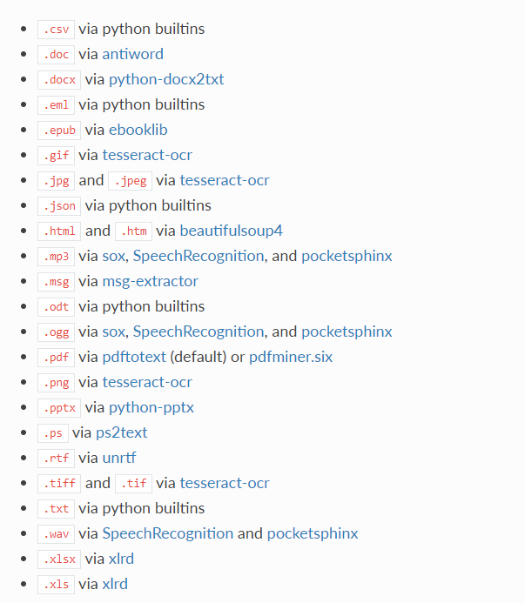
Textract
This package provides a single interface for extracting content from any type of file, without any irrelevant markup.

Slide 5
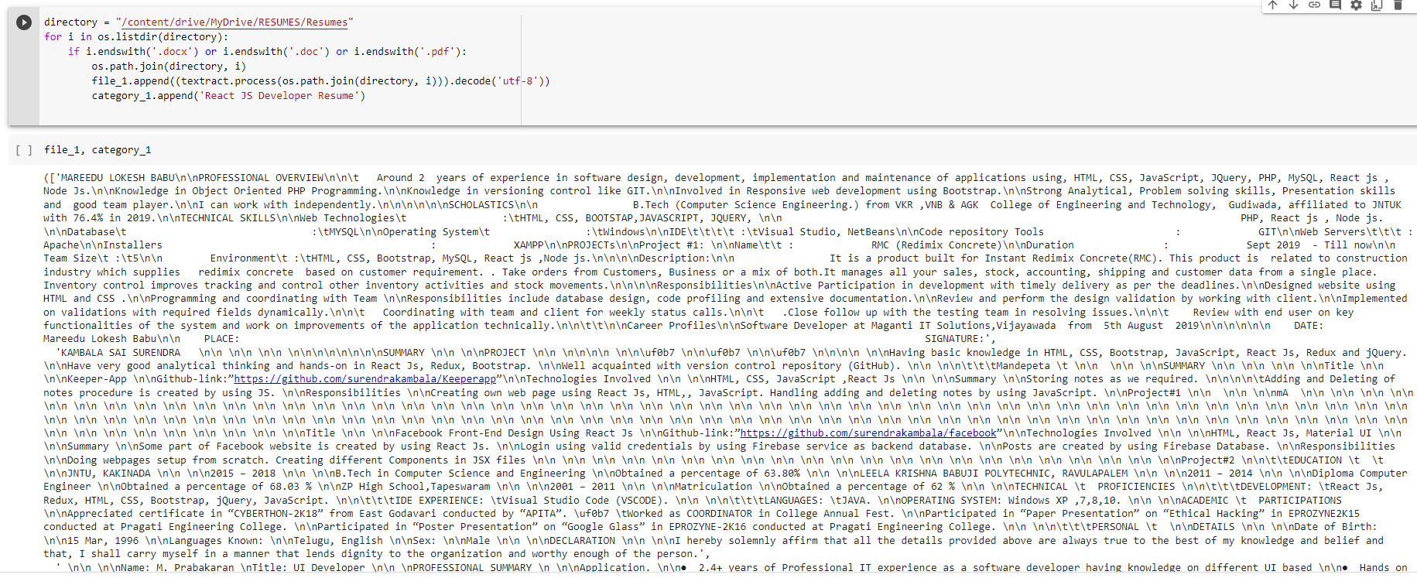
Converting all file to .txt (Process)

Slide 6
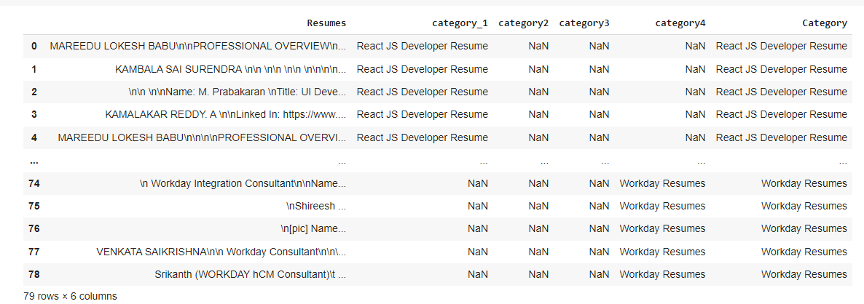
Merging all category files.

Slide 7
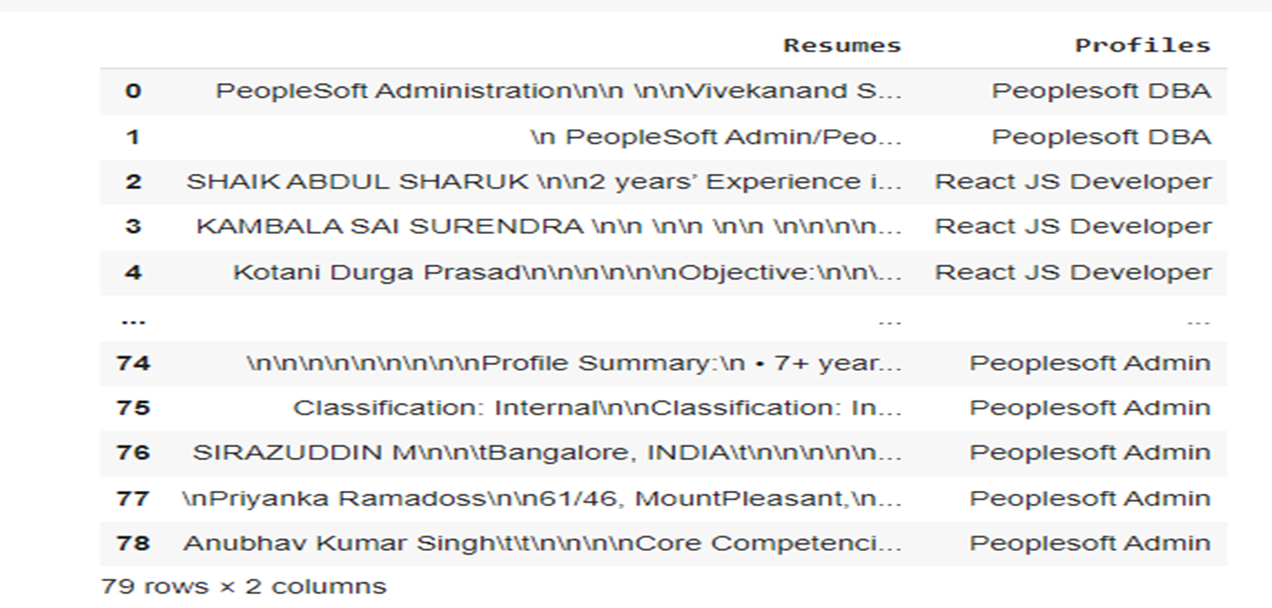
Converting text to .csv (Process)

Slide 8
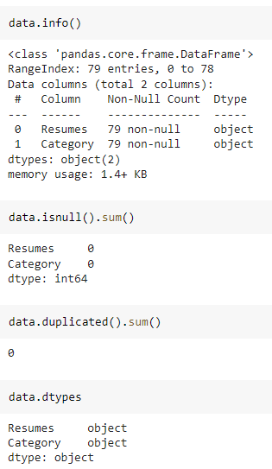
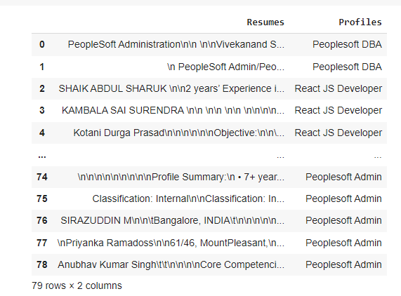
Data Set Details
After Extracting and Modifying the Dataset, given data contains a total of 4 Classes and 79 rows .

Slide 9
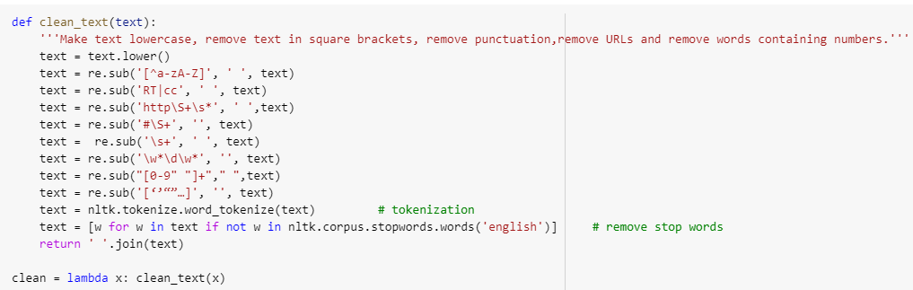
Removing All Unwanted Character’s
Unwanted Character’s like - \n \t, http links, tags, hashtags, html tags, converting to lower case, removing white spaces etc.
Word Tokenization - Tokenization is essentially splitting a phrase, sentence, paragraph, or an entire text document into smaller units, such as individual words or terms. Each of these smaller units are called tokens.
Removing Stop-words - A stop word is a commonly used word (such as “the”, “a”, “an”, “in”) that a search engine has been programmed to ignore, both when indexing entries for searching and when retrieving them as the result of a search query.

Slide 10
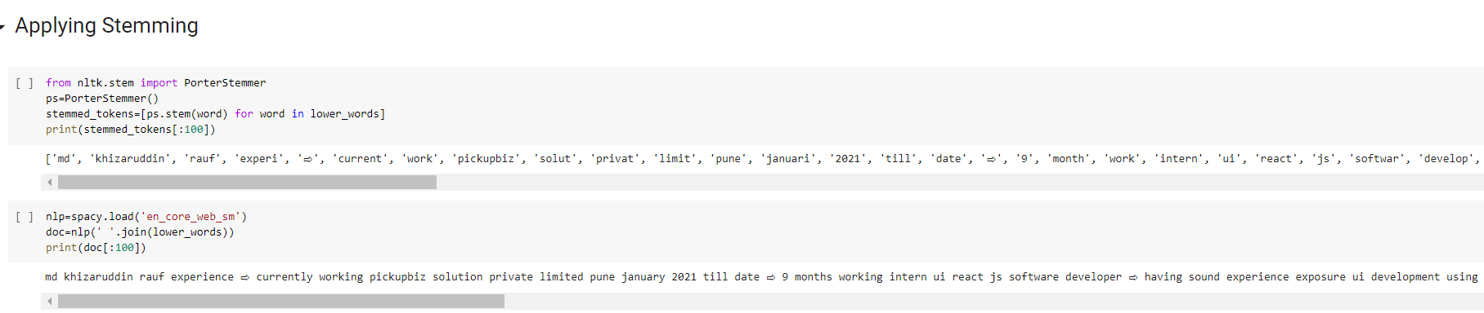
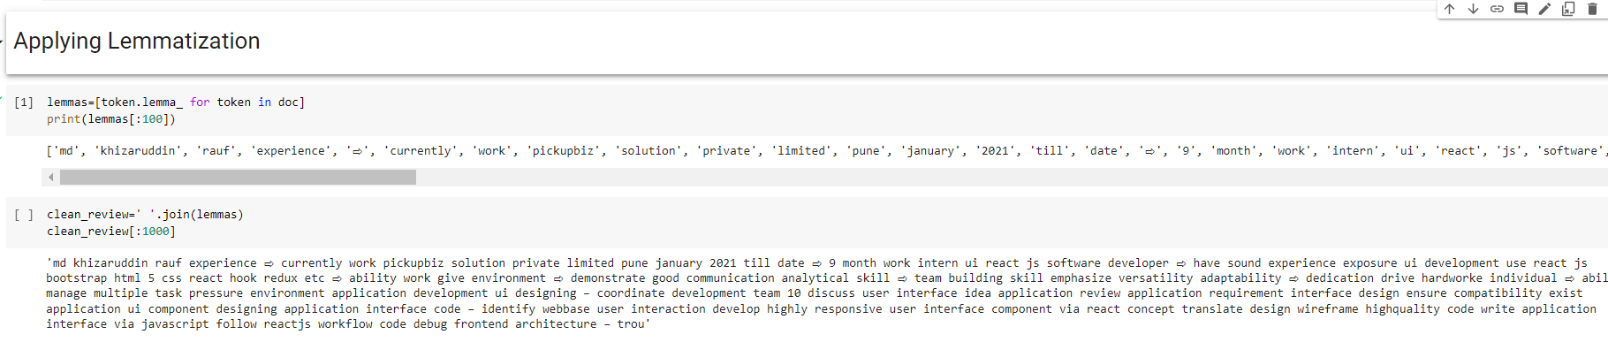
Text – Preprocessing
The Porter stemming algorithm (or 'Porter stemmer') is a process for removing the commoner morphological and inflectional endings from words in English.

Slide 11
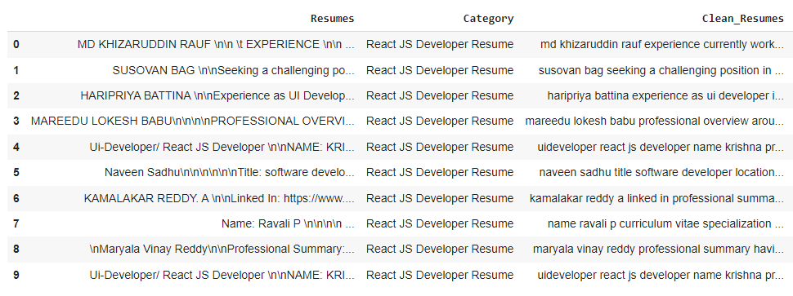
Text – Preprocessing
In natural language processing, text preprocessing is the practice of cleaning and preparing text data. NLTK and re are common Python libraries used to handle many text preprocessing tasks.
Before Text – Preprocessing After Text – Preprocessing
The Dataset contains 79 rows and 3 Column
There are total four Classes – Peoplesoft, Workday, React JS Developer and SQL Developer.

Slide 12
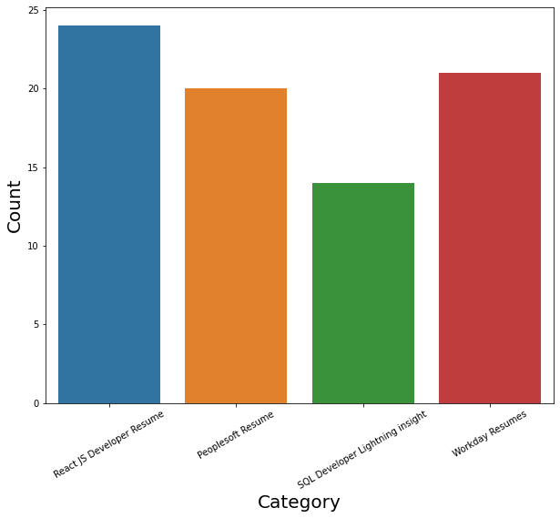
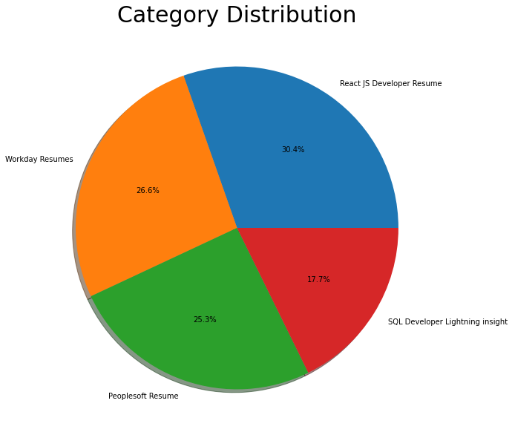
Labels
By using Pie chart roles applied feature is displayed to visualize the job roles.
By using Histogram roles applied feature is displayed to check the job types.

Slide 13
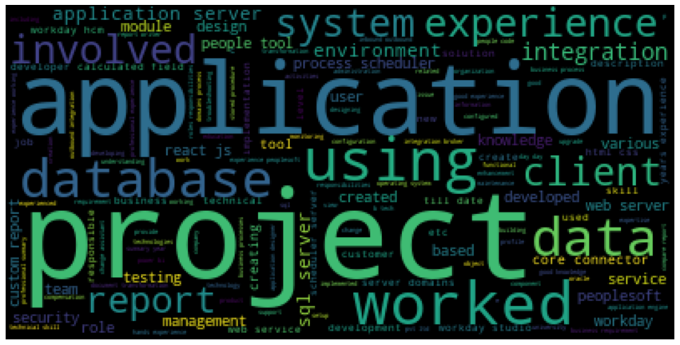
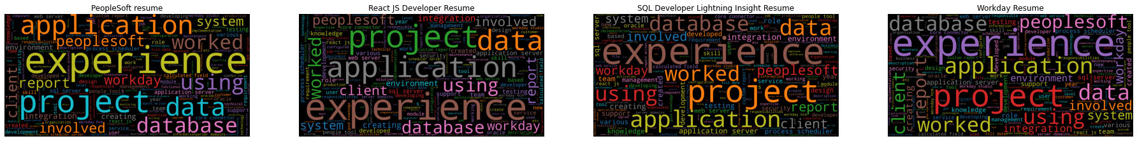
Word cloud

Slide 14
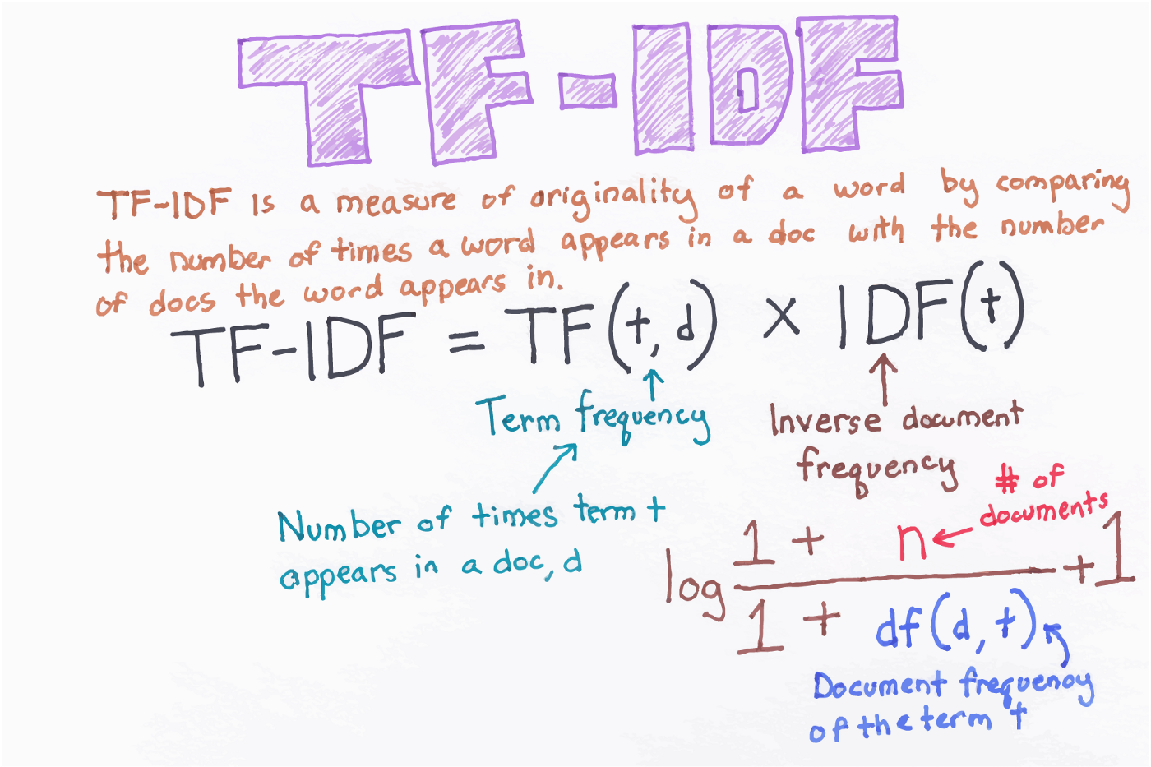
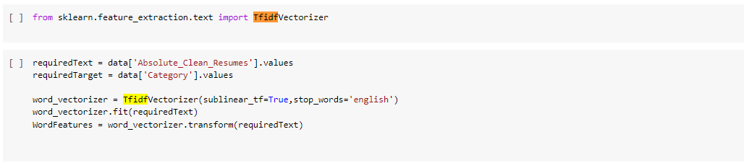
TF-IDF
TF-IDF is better than Count Vectorizers because it not only focuses on the frequency of words present in the corpus but also provides the importance of the words.
We can then remove the words that are less important for analysis, hence making the model building less complex by reducing the input dimensions.

Slide 15
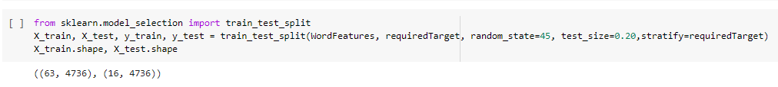

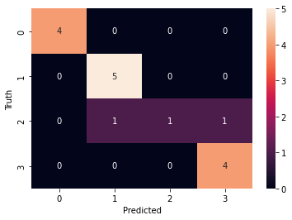
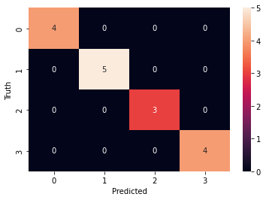
Before Stratified Sampling
Train-Test Split
4
5
3
4
After Stratified Sampling

Slide 16
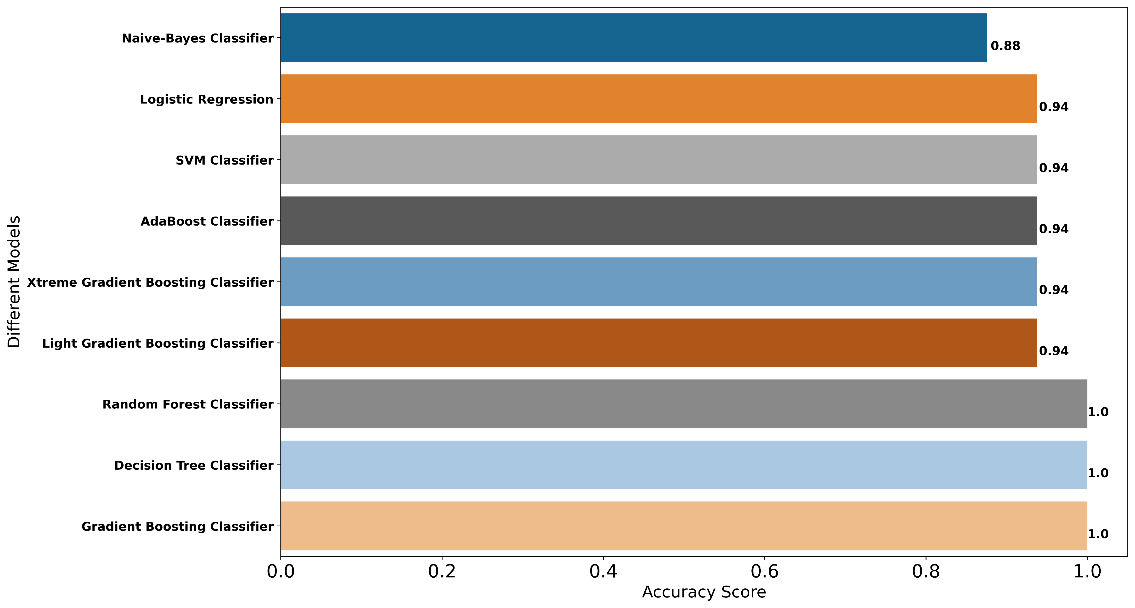
Model- Building
Accuracy on Testing Data

Slide 17
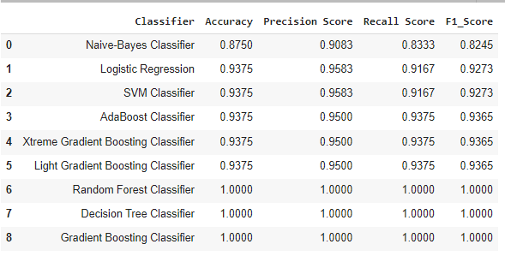
Model- Evaluation
Metrics on Testing Data
Here, we have taken Model building algorithms such as Decision Tree Classifier, Logistic Regression, SVM, Random , Forest, etc.
Among these algorithms, 100% Accuracy, Precision, Recall and F1-score have been achieved.
100% accuracy is achieved by using the model Random Forest, Decision Tree and Gradient Boosting Classifier.

Slide 18
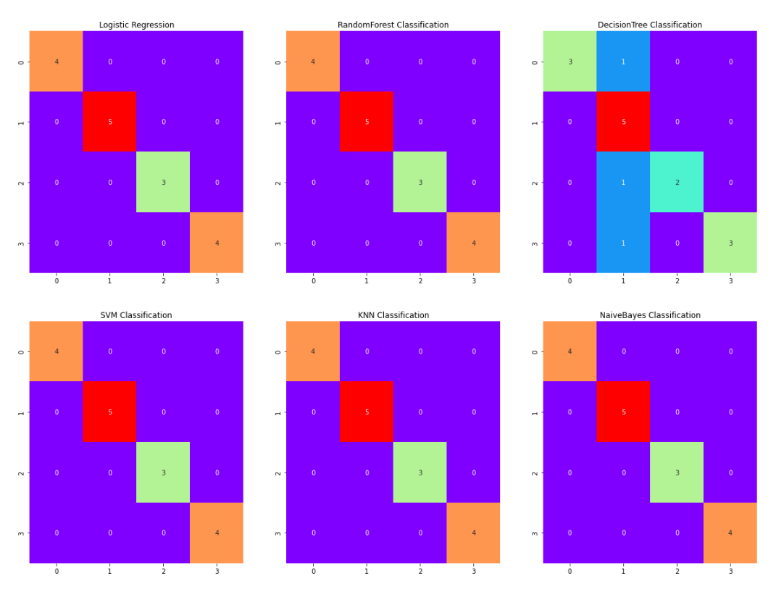
Model- Evaluation
Here, we have taken Model building algorithms such as Decision Tree Classifier, Logistic Regression, SVM, Random , Forest, etc.
Among these algorithms, 100% Accuracy, Precision, Recall and F1-score have been achieved.
100% accuracy is achieved by using the model Random Forest, Decision Tree and Gradient Boosting Classifier.

Slide 19
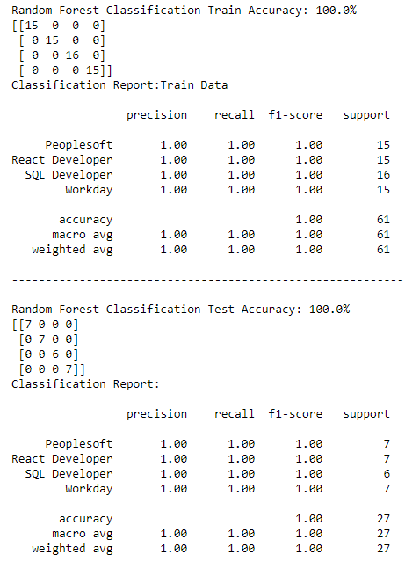
Model-Evaluation Report
Random Forest Classification
Here, we have taken Random Forest Model.
100% Accuracy, Precision, Recall and F1-score have been achieved.
No overfitting or underfitting has been found. All classes are classified correctly and no misclassification.

Slide 20
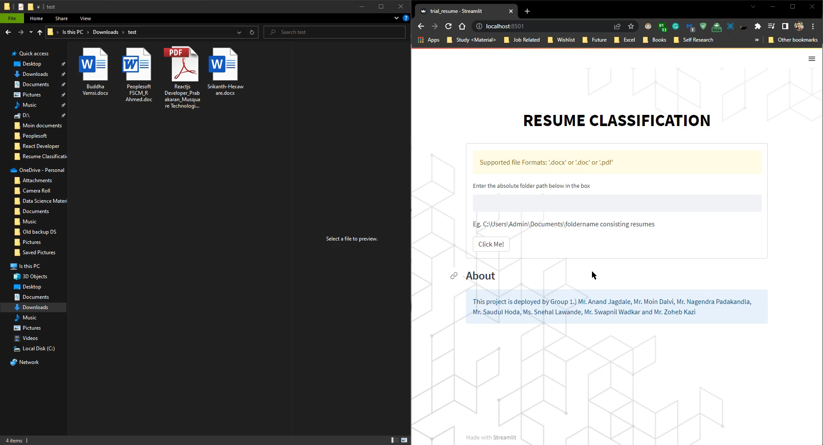
Deployment

Slide 21
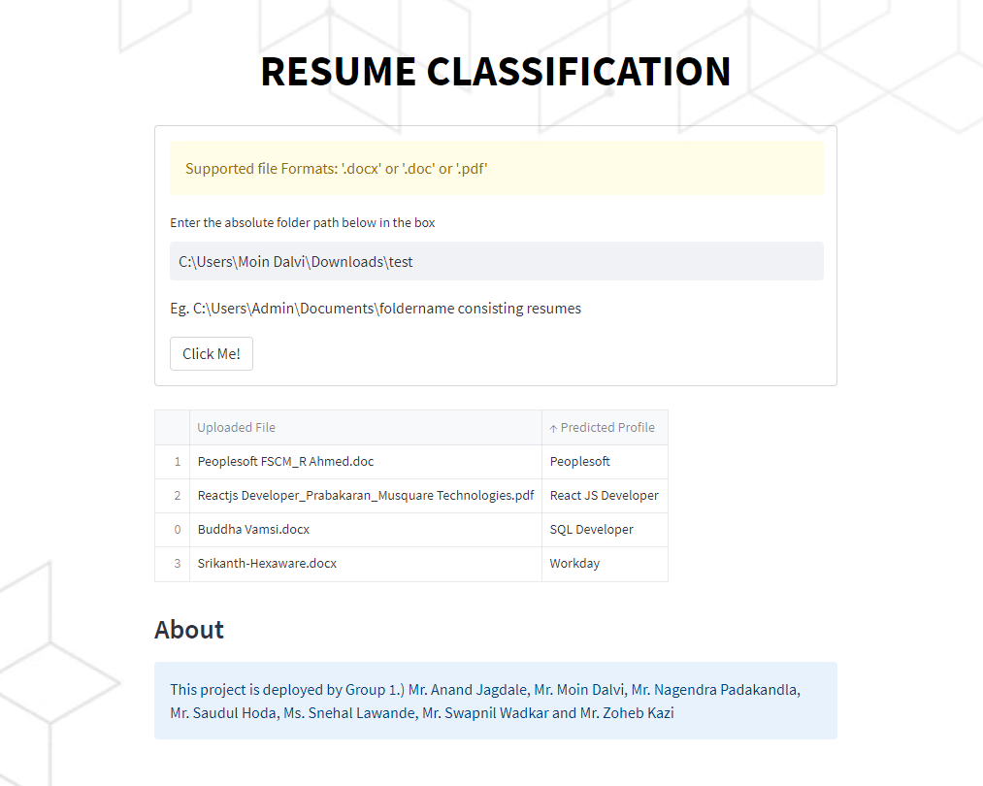
Deployment
Here, we have taken Random Forest as our Final Model algorithms for the deployment.
The algorithm has achieved 100% Accuracy, Precision, Recall and F1-score on testing data.
100% accuracy is achieved by using the model Random Forest no misclassification on validation set.
We have deployed the Resume Classification using Stream-lit as the platform

Slide 22
Thank you

